Slide 1
GENERAL Indian election analysis using Power Bi presented By Daniya Ansari

Slide 2
WHAT IS power bi?
Data Connectivity and Integration:
Power BI can connect to a wide range of data sources, including databases, cloud services, Excel spreadsheets, and on-premises data sources. This flexibility makes it easy to consolidate data from multiple sources into a single, cohesive view.
Interactive Visualizations:
Users can create a variety of visualizations, such as charts, graphs, maps, and tables, which can be easily customized and interacted with. These visualizations help in exploring and presenting data insights effectively.
User-Friendly Interface:
Power BI offers an intuitive drag-and-drop interface, making it accessible to users with varying levels of technical expertise. This user-friendly design allows users to quickly build and modify reports and dashboards without needing extensive coding skills.
Collaboration and Sharing:
Power BI provides robust collaboration features, allowing users to share reports and dashboards with colleagues and stakeholders. Reports can be published to the Power BI service, embedded in other applications

Slide 3
Aims & Objective:
Data Integration: Merge election results with party alliance data to see which alliances lead or trail in constituencies.
Data Cleaning: Check for and fix missing values and errors in dataset.
Data Analysis & Visualization:
-Overall Results: Summary of seats won by each party/alliance.
-State-wise Analysis: Performance across states.
-Constituency-wise Analysis: Victory/defeat margins.
-Comparison: Compare party/alliance performance in seats won and margins.

Slide 4
Aims & Objective:
Interactive Dashboard:
-Trend Analysis: Identify voting patterns.
-Filters: Explore data by state, constituency, party, and alliance.
-KPIs: Display total seats, average margin, and constituencies won.
Insights & Recommendations:
-Report: Summarize key insights.
-Strategies: Recommend improvements for future elections.

Slide 5

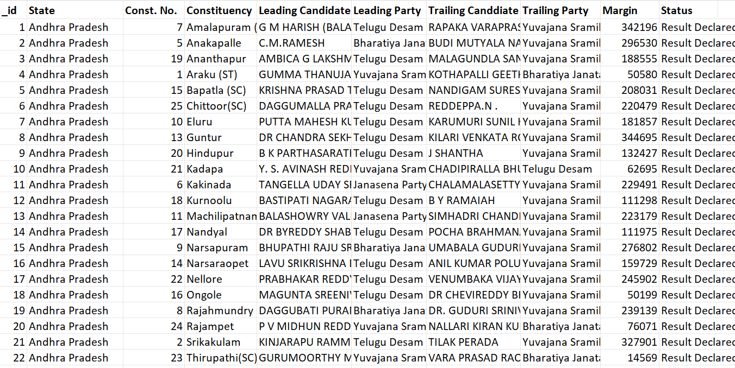
DataSets : election Details

Slide 6
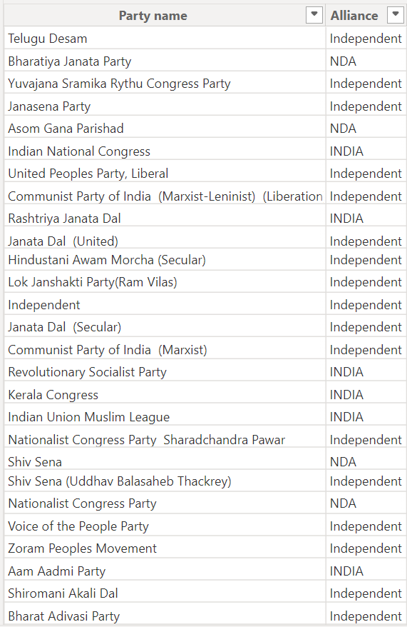
DataSets : Alliance details

Slide 7
Data Description:
1. Election Results Data:
- `_id`: Unique identifier for each record.
- `State`: Name of the state.
- `Const. No.`: Constituency number.
- `Constituency`: Name of the constituency.
- `Leading Candidate`: Name of the leading candidate.
- `Leading Party`: Name of the leading party.
- `Trailing Candidate`: Name of the trailing candidate.
- `Trailing Party`: Name of the trailing party.
- `Margin`: Vote margin between the leading and trailing candidates.
`Status`: Status of the election result (e.g., Won, Lost, Leading, Trailing).
2. Party Alliance Data:
- `Party Name`: Name of the political party.
- `Alliance Name`: Name of the political alliance the party belongs to.

Slide 8
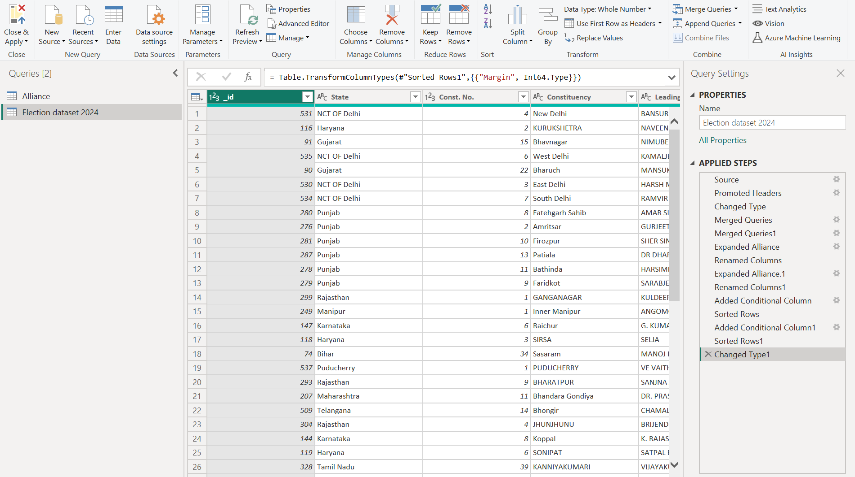
loading data and Transformation in power Bi​
HOME TAB
GET DATA
SELECT DATA TYPE
SELECT DATA
LOAD AND TRANSFORM

Slide 9
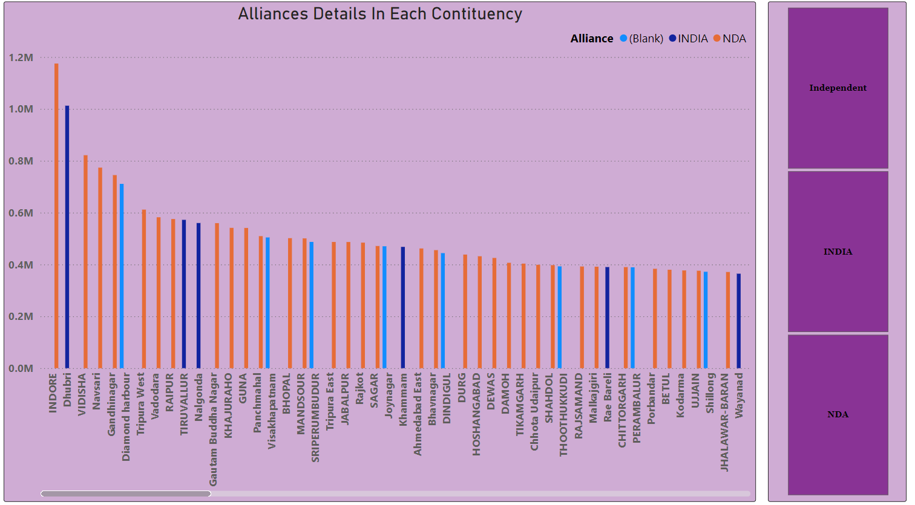
Data Integration:
Combine the election results data with the party alliance data to get a comprehensive view of which alliances are leading or trailing in various constituencies.

Slide 10
Data cleaning and preparation:​
Ensure data quality by checking for missing values, inconsistencies, and correcting any errors in the datasets.

Slide 11
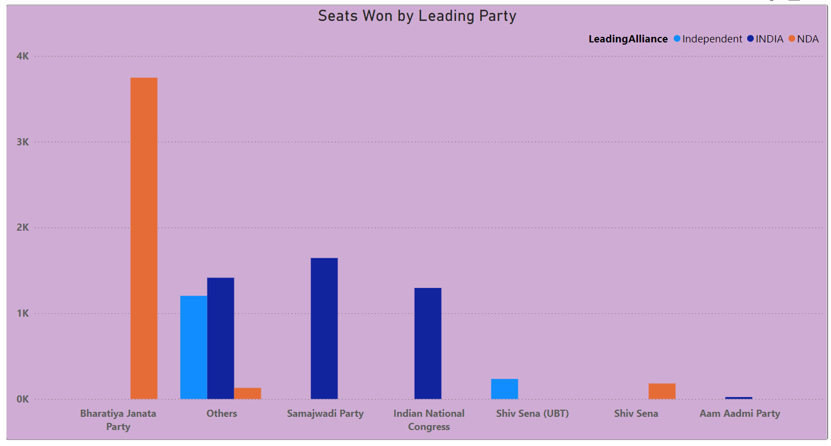
Data Analysis & Visualization:​
Overall Results: Create a summary of the overall election results including the total number of seats won by each party and alliance.

Slide 12
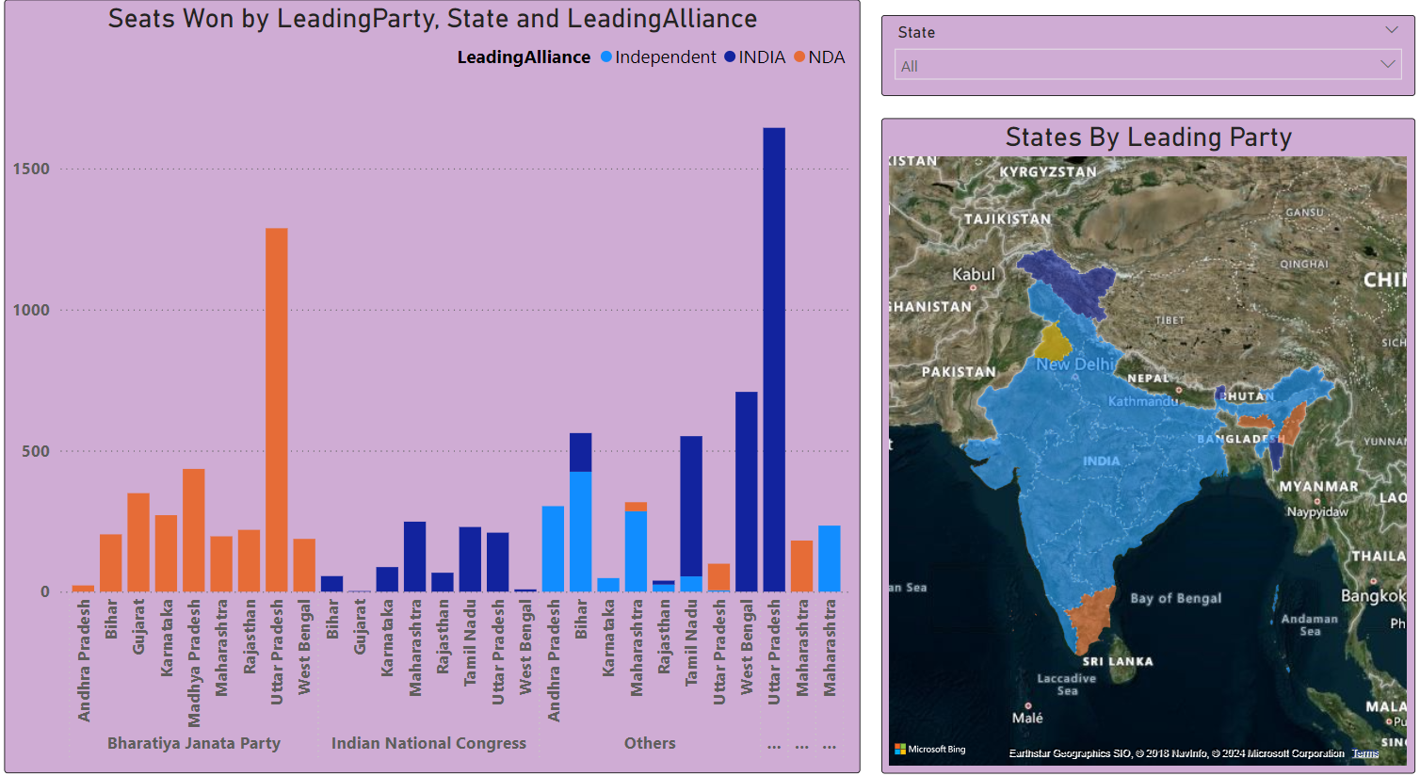
Data Analysis & Visualization:​
State-wise Analysis: Visualize the performance of leading parties and alliances across different states.

Slide 13
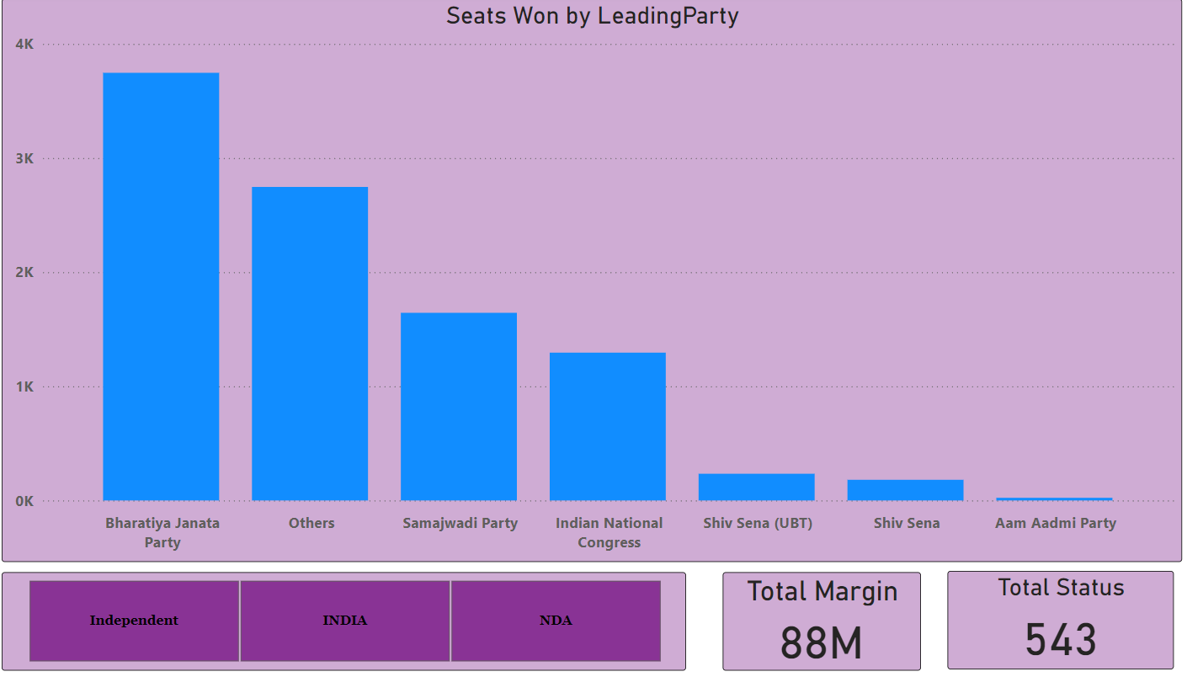
Data Analysis & Visualization:​
Party and Alliance Comparison: Compare the performance of different parties and their respective alliances in terms of seats won, margins, and status.

Slide 14
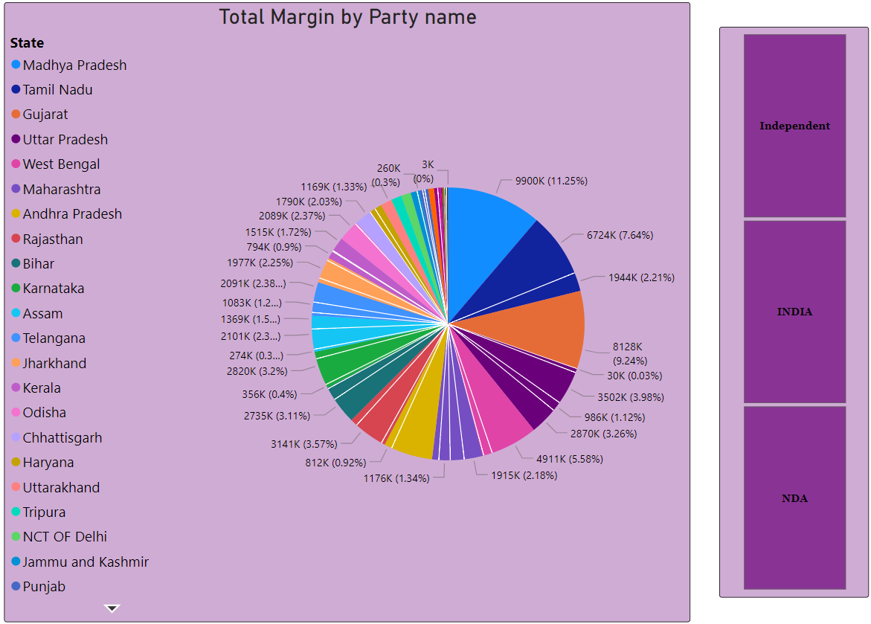
Interactive dashboard:​
Trend Analysis: Identify and visualize trends in voting patterns, such as regions with high competition
(small margins) or dominance by specific parties or alliances.

Slide 15
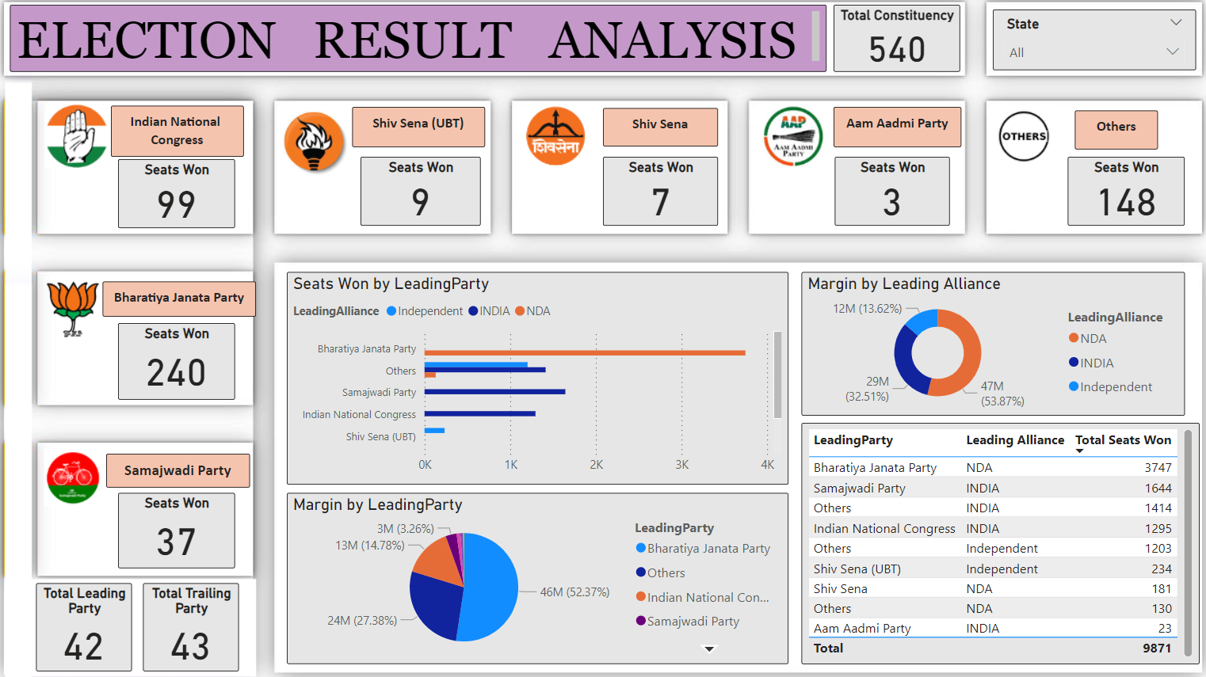
Interactive dashboard:​
Create an interactive dashboard that allows users to filter and explore the data by state, constituency,
party, alliance, and status.

Slide 16
Insights:
📊 Overall Performance:
NDA leads across all other alliances in all constituencies with a total margin of 1.18 million.
🏆 Constituency with Highest Margin:
Indore constituency has the highest total margin of 1.175 million.
🥇 Seats Won:
Bharatiya Janata Party (BJP) and its alliances in NDA have won the highest number of seats with 239.
🗺️ State-wise Leading Alliances:
NDA alliances are leading in the majority of states.
INDIA alliances are in second place.
⚖️ Small Margin Competitions:
The last 10 parties and alliances are involved in close contests.
These close competitions are taking place in Kerala, Bihar, and Maharashtra.
📈 Performance Metrics:
-BJP and NDA have:
47 million total margin.
252 total won areas.
239 seats for BJP.

Slide 17
Competitors and Alliances:
Competitors and Alliances:
INC (Indian National Congress) and BJP (Bharatiya Janata Party) are the major competitors across all other parties.
The major alliances are NDA (National Democratic Alliance) and INDIA (Indian National Developmental Inclusive Alliance).

Slide 18
Strategic Recommendations for INC: ​
Localize Campaigns:
Focus on state-level campaigns.
Cultivate strong local leaders.
Address region-specific issues.
Objective: Connect with voters and build trust.
2. Target Direct Contests:
Focus on winning direct contests against BJP.
Goal: Win around 50 of the 200-odd direct contest seats with BJP.
Outcome: Help INC cross the 100-seat mark.
3. Strategic Alliances:
Collaborate with like-minded parties such as:
Samajwadi Party (SP), Rashtriya Janata Dal (RJD), Shiv Sena
Implement strategic seat-sharing.
Objective: Optimize chances of victory in specific constituencies.
4. Focus on Key States:
Prioritize states where INC has historically performed well:
Kerala, Punjab, Parts of Karnataka
Objective: Consistent victories in these states to contribute significantly to the overall seat count.
5. Address Voter Concerns:
Focus on addressing issues such as:
Joblessness, Rising prices. Economic challenges
Objective: Connect with voters and resonate positively by addressing their concerns.

Slide 19
THANK YOU!

